Slide 1


IT355: SOFTWARE ENGINEERING
December 2021– April 2022
UNIT 2
Agile Development

Slide 2


Content
Agility and Agile Process Model
Extreme Programming
Other Process Models of Agile Development and Tools
Unit 2

Slide 3
What is “Agility”?
Effective (rapid and adaptive) response to change
Effective communication among all stakeholders
Drawing the customer onto the team
Organizing a team so that it is in control of the work performed
Yielding …
Rapid, incremental delivery of software
Unit 2

Slide 4
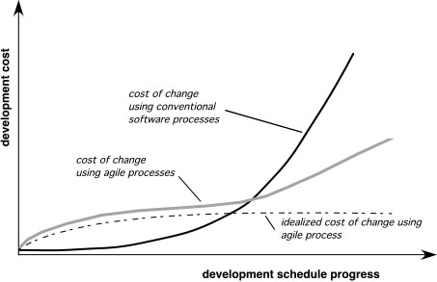
Agility and the Cost of Change
Unit 2

Slide 5
An Agile Process
Is driven by customer descriptions of what is required (scenarios)
Recognizes that plans are short-lived
Develops software iteratively with a heavy emphasis on construction activities
Delivers multiple ‘software increments’
Adapts as changes occur
Unit 2

Slide 6
Agility Principles - I
1. Our highest priority is to satisfy the customer through early and continuous delivery of valuable software.
2. Welcome changing requirements, even late in development. Agile processes harness change for the customer's competitive advantage.
3. Deliver working software frequently, from a couple of weeks to a couple of months, with a preference to the shorter timescale.
4. Business people and developers must work together daily throughout the project.
5. Build projects around motivated individuals. Give them the environment and support they need, and trust them to get the job done.
6. The most efficient and effective method of conveying information to and within a development team is face–to–face conversation.
Unit 2

Slide 7
Contd…
7. Working software is the primary measure of progress.
8. Agile processes promote sustainable development. The sponsors, developers, and users should be able to maintain a constant pace indefinitely.
9. Continuous attention to technical excellence and good design enhances agility.
10. Simplicity – the art of maximizing the amount of work not done – is essential.
11. The best architectures, requirements, and designs emerge from self–organizing teams.
12. At regular intervals, the team reflects on how to become more effective, then tunes and adjusts its behavior accordingly.
Unit 2

Slide 8
Human Factors
the process molds to the needs of the people and team, not the other way around
key traits must exist among the people on an agile team and the team itself:
Competence.
Common focus.
Collaboration.
Decision-making ability.
Fuzzy problem-solving ability.
Mutual trust and respect.
Self-organization.
Unit 2

Slide 9
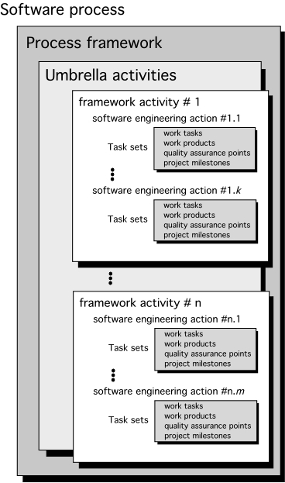
Process Models
Generic Process Model
Unit 2

Slide 10
Extreme Programming (XP)
The most widely used agile process, originally proposed by Kent Beck
XP Planning
Begins with the creation of “user stories”
Agile team assesses each story and assigns a cost
Stories are grouped to for a deliverable increment
A commitment is made on delivery date
After the first increment “project velocity” is used to help define subsequent delivery dates for other increments
Unit 2

Slide 11
Contd…
XP Design
Follows the KIS principle
Encourage the use of CRC (Class-responsibility-collaboration) cards (see Chapter 8)
For difficult design problems, suggests the creation of “spike solutions”—a design prototype
Encourages “refactoring”—an iterative refinement of the internal program design
XP Coding
Recommends the construction of a unit test for a store before coding commences
Encourages “pair programming”
XP Testing
All unit tests are executed daily
“Acceptance tests” are defined by the customer and executed to assess customer visible functionality
Unit 2

Slide 12
Contd…
Unit 2

Slide 13
Other Agile Process Models
It includes:
Adaptive Software Development (ASD)
Scrum
Dynamic Systems Development Method (DSDM)
Crystal
Feature Driven Development (FDD)
Lean Software Development (LSD)
Agile Modeling (AM)
Agile Unified Process (AUP)
Unit 2

Slide 14
Adaptive Software Development
Originally proposed by Jim Highsmith
ASD — distinguishing features
Mission-driven planning
Component-based focus
Uses “time-boxing”
Explicit consideration of risks
Emphasizes collaboration for requirements gathering
Emphasizes “learning” throughout the process
Unit 2

Slide 15
Adaptive Software Development
Unit 2

Slide 16
Dynamic Systems Development Method
DSDM Life Cycle (with permission of the DSDM consortium)
Unit 2

Slide 17
Scrum
Originally proposed by Schwaber and Beedle
Scrum—distinguishing features
Development work is partitioned into “packets”
Testing and documentation are on-going as the product is constructed
Work occurs in “sprints” and is derived from a “backlog” of existing requirements
Meetings are very short and sometimes conducted without chairs
“demos” are delivered to the customer with the time-box allocated
Unit 2

Slide 18
Crystal
Proposed by Cockburn and Highsmith
Crystal—distinguishing features
Actually a family of process models that allow “maneuverability” based on problem characteristics
Face-to-face communication is emphasized
Suggests the use of “reflection workshops” to review the work habits of the team
Unit 2

Slide 19
Feature Driven Development
Reprinted with permission of Peter Coad
Unit 2

Slide 20
Lean software development (LSD)
It has adapted the principles of lean manufacturing to the world of software engineering.
The lean principles can be summarized as:
Eliminate waste
Build quality in
Create knowledge
Defer commitment
Deliver fast
Respect people
Optimize the whole
Unit 2

Slide 21
Each of these principles can be adapted to the software process.
Example: eliminate the waste within the context of an agile software project can be interpreted to mean:
Adding no extraneous features or functions
Assessing the cost and schedule impact of any newly requested requirement.
Removing any superfluous process steps
Establishing the mechanisms to improve the way team members find information
Ensuring the testing finds as many errors as possible
Reducing the time required to request and get a decision that affects the software or the process that is applied to create it.
Streaming the manner in which information is transmitted to all stakeholders involved in the process
Unit 2

Slide 22
Agile Modeling
Originally proposed by Scott Ambler
Suggests a set of agile modeling principles
Model with a purpose
Use multiple models
Content is more important than representation
Know the models and the tools you use to create them
Adapt locally
Unit 2

Slide 23
Agile Unified Process (AUP)
It adopts a “serial in the large” and the “iterative in the small” philosophy for building computer-based systems.
By adopting the classic UP phased activities:
Inception
Elaboration
Construction
Transition
AUP provides a linear sequence of software engineering activities that enables the team to visualize the overall process flow for a software project.
Unit 2

Slide 24
Each AUP iteration addresses the following activities:
Modeling
Implementation
Testing
Deployment
Configuration and Project Management
Environment Management
Unit 2

Slide 25
Tool Set for the Agile Process
The tool set supports agile processes that focus more on people issues than it does on the technology issues.
Active communication is achieved via the team dynamics while passive communication is achieved by “information radiators” (eg. A flat panel display that presents the overall status of different components of an increment).
Project management tools deemphasize the Gantt Chart and replace it with earned value charts or “graphs of tests created versus passed”… other agile tools are used to optimise the environment in which the agile team works, improve the team culture by nurturing the social interactions, physical devices and process enhancement
Unit 2

Slide 26


